Slide 1
CSS (Cascading Style Sheet)
Instructor : Engr. Ayesha Khan

Slide 2
Introduction
A simple mechanism for controlling the style of a Web document without compromising its structure.
It allows you to separate visual design elements (layout, fonts, colors, margins, and so on) from the contents of a Web page.
Allows for faster downloads, streamlined site maintenance, and global control of design attributes across multiple pages.

Slide 3
What can we do with CSS that we can’t do with HTML?
Control of backgrounds.
Set font size to the exact height you want.
Highlight words, entire paragraphs, headings or even individual letters with background colors.
Overlap words and make logo-type headers without making images.
Precise positioning.
Linked style sheets to control the look of a whole website from one single location.
And more

Slide 4
Writing CSS
Selector
HTML element tags (examples: p, h2, body, img, table)
class and ID names
Property (examples: color, font-size)
Value (examples: red, 14pt)

Slide 5
Writing CSS
The basic syntax of a CSS rule:
selector {property 1: value 1; property 2: value 2}
Example:
p {font-size: 8pt; color: red}
Notice the { } around the rule and the : before each value!

Slide 6
Levels of Style Sheet
There are four ways to associate styles with your HTML document. Most commonly used
inline CSS
<p style="text-indent: 10pt">indented paragraph</p>
Document
<head>
<style type="text/css" media="all">
Style Rules
............
</style>
</head>

Slide 7
Levels of Style Sheet
External CSS
<head>
<link type="text/css" href="Style.css" rel="stylesheet" />
</head>
Imported CSS rules
<head> <@import url("URL"); </head>
<head> @import "mystyle.css"; </head>

Slide 8
CSS Rule
A CSS comprises of style rules that are interpreted by the browser and then applied to
the corresponding elements in your document. A style rule is made of three parts: selector, property and its value. Declaration is shown below.
Selector
{
Property_1 :value_1 ;
Property-2 :value_2;
Property_3 : value_3;
}

Slide 9
Types of Selector
Simple Selector
Universal Selector
Grouping Selectors
Type Selector
Descendant Selector
Class Selector
ID selector
Child Selector

Slide 10
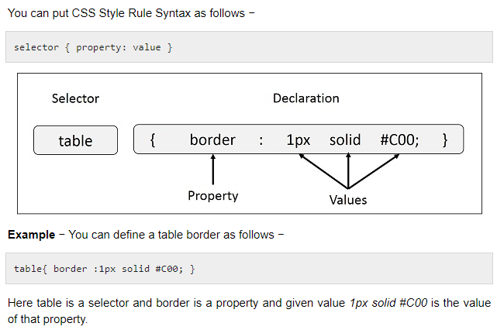
Example

Slide 11
TYPES OF SELECTORS
SIMPLE SELECTORcs
H1 { property_1 : value_1;} H1, h2 { Property-1 :value_1; Property_2 : value_2; | H1 { Background-color : green ; Font-family : Times new Romen; }
UNIVERSAL SELECTOR
*{ Property-1 :value_1; Property_2 : value_2;} | *{ Background-color : green ; Font-family : Times new Romen;}
DECENDANT SELECTORS
ul em { Property-1 :value_1; Property_2 : value_2;}

Slide 12
TYPES OF SELECTORS
CLASS SELECTORS
.black { color: #000000; }
h1.black { color: #000000;}
<h1 class=”black”> heading </h1> <p class="black"> This para will be styled by the classes center and bold.</p>
ID SELECTORS
h1#black { color: #000000; } #black { color: #000000; }

Slide 13
TYPES OF SELECTORS
CHILD SELECTORS
body > p { color: #000000; }
GROUPING SELECTORS (TYPE SELECTOR)
h1, h2, h3 { color: #36C; font-weight: normal; letter-spacing: .4em; margin-bottom: 1em; text-transform: lowercase; }

Slide 14
MULTIPLE STYLE RULES
h1 { color: #36C; font-weight: normal; letter-spacing: .4em; margin-bottom: 1em; text-transform: lowercase; }

Slide 15
CSS Box Model
The “Box Model” is a tool we use to lay out our web pages in a number of individual "boxes" or "containers". When we plan our web page design, we must take into account not only the size of page content, but also the margins, borders, and padding involved.
Before we start building a page, we can plan where everything will go by arranging these boxes on the screen. Our goal is to create a balanced layout, with plenty of "white space" around the content.

Slide 16
The Component of a Box
Margin
Border
Padding
Content

Slide 17
<div> Tag
The <div> tag is our basic building block when laying out a page design. By defining the height and width of the <div>, we are "reserving" that amount of space on the screen for whatever content we wish to place there.
The actual content will go inside the opening <div> and closing </div> tags.

Slide 18
Example <div>:
<head>
<style type="text/css">
.box300 {
width:300px;
height:300px;
border:1px solid black;
}
</style>
</head>
This is a 300 by 300 pixel box with a 1 px border.
<div class="box300">
This is a 300 by 300 pixel box
with a 1px border.
</div>
This is outside the box.
This is outside the box.
By establishing the box dimensions, we can leave it there as a placeholder until we have our content ready. In the meantime, the rest of the page can be built out with our other content.

Slide 19
Adding padding:
<head>
<style type="text/css">
.box300 {
width:300px;
height:300px;
border:1px solid black;
padding:10px;
}
</style>
</head>
This is a 300 by 300 pixel box with a 1px border and 10px padding.
<div class="box300">
This is a 300 by 300 pixel box
with a 1px border and 10px
padding.
</div>
<p>This is outside the box.</p>
This is outside the box.
By adding 10px of padding on all four sides of the content, we have effectively made our box 320px by 320px (321px by 321px with the border).

Slide 20
Adding margin:
<head>
<style type="text/css">
.box300 {
width:300px;
height:300px;
border:1px solid black;
padding:10px;
margin:10px;
}
</style>
</head>
This is a 300 by 300 pixel box with a 1px border and 10px padding and 10px margin.
The dotted line here shows where the margin is but it will not show on the actual page.
This is outside the box.
<div class="box300">
This is a 300 by 300 pixel box
with a 1px border and 10px
Padding and 10px margin.
</div>
<p>This is outside the box.</p>
By adding 10px of margin on all four sides of the border, we have now made our box 341px by 341px overall.

Slide 21
Calculating overall dimensions:
When designing our page, we have to calculate how much size a <div> element will consume:
Total element width = defined width + left padding + right padding + left border + right border + left margin + right margin.
Total element height = defined height + top padding + bottom padding + top border + bottom border + top margin + bottom margin

Slide 22
Pixels vs. Percent:
The width property can be specified in pixels or in percent. By using "width:50%", we are telling the browser to make the width of the element exactly 50% of the space available.
Using percent instead of pixels can make our page layout highly flexible. For example, we can use the entire screen real estate, no matter what size screen or resolution our web visitor has.

Slide 23
A technique to center a <div>:
Because we don't know what the screen resolution will be for our visitors, it can be challenging to get our pages to display attractively for all viewers.
A useful technique is to set the right and left margins of a <div> to the value "auto". This tells the browser to maintain an equal distance on the right and left, effectively centering the <div> no matter how wide the available area is: .centerme { margin:0 auto; }
This same technique can be used on a <div> element that contains all your page content in order to center your page on the screen, no matter what the screen resolution of your web visitor.

Slide 24
CSS BACKGROUNDS
The background-color property is used to set the background color of an element.
The background-image property is used to set the background image of an element.
The background-repeat property is used to control the repetition of an image in the background.
The background-position property is used to control the position of an image in the background.
The background-attachment property is used to control the scrolling of an image in the background.
The background property is used as a shorthand to specify a number of other background properties.

Slide 25
CSS FONTS
The font-family property is used to change the face of a font.
The font-style property is used to make a font italic or oblique.
The font-variant property is used to create a small-caps effect.
The font-weight property is used to increase or decrease how bold or light a font appears
The font-size property is used to increase or decrease the size of a font.
The font property is used as shorthand to specify a number of other font properties.

Slide 26
<html lang = "en"> <head> <style type = "text/css"> p { color : blue; font-family:georgia,garamond,serif; font-style:italic; font-variant:small-caps; font-weight:bold; font-size:small; font-size-adjust:0.61; font-stretch:ultra-expanded; /* font:italic small-caps bold 15px georgia;*/ } </style> </head> <title> css fonts </title> <body> <p> A CSS comprises of style rules that are interpreted by the browser and then applied to the corresponding elements in your document. A style rule is made of three parts: </p> </body> </html>

Slide 27
CSS TEXT
The color property is used to set the color of a text.
The direction property is used to set the text direction.
The letter-spacing property is used to add or subtract space between the letters that make up a word.
The word-spacing property is used to add or subtract space between the words of a sentence.
The text-indent property is used to indent the text of a paragraph.
The text-align property is used to align the text of a document.
The text-decoration property is used to underline, overline, and strikethrough text.
The text-transform property is used to capitalize text or convert text to uppercase or lowercase letters.
The white-space property is used to control the flow and formatting of text.
The text-shadow property is used to set the text shadow around a text.

Slide 28
<html lang = "en"> <head> <style type = "text/css"> p { color : red; direction:rtl; letter-spacing:5px; word-spacing:5px; text-indent:1cm; text-align:right; text-transform:capitalize; text-shadow:4px 4px 8px blue; } </style> </head> <title> css fonts </title> <body> <p> A CSS comprises of style rules that are interpreted by the browser and then applied to the corresponding elements in your document. A style rule is made of three parts: </p> </body> </html>

Slide 29
CSS BORDERS
The border-collapse specifies whether the browser should control the appearance of the adjacent borders that touch each other or whether each cell should maintain its style.
The border-spacing specifies the width that should appear between table cells.
The caption-side captions are presented in the <caption> element. By default, these are rendered above the table in the document. You use the caption-side property to control the placement of the table caption.
The empty-cells specifies whether the border should be shown if a cell is empty.
The table-layout allows browsers to speed up the layout of a table by using the first width properties it comes across for the rest of a column rather than having to load the whole table before rendering it.

Slide 30
<style type="text/css"> table.one {border-collapse:collapse;} table.two {border-collapse:separate;} td.a { border-style:dotted; border-width:3px; border-color:#000000; padding: 10px; } td.b {border-style:solid; border-width:3px; border-color:#333333; padding:10px; } </style>

Slide 31
Flex Property
The flex CSS shorthand property is the combination of flex-grow, flex-shrink, and flex-basis property.
It is used to set the length of flexible items.
The flex property is much responsive and mobile-friendly and easy to position child elements and the main container.
The margin doesn’t collapse with the content margins. The order of any element can be easily changed without editing the HTML section.
flex: flex-grow flex-shrink flex-basis|auto|initial|inherit;

Slide 32
<!DOCTYPE html>
<html>
<head>
<title> CSS flex Property </title>
<style>
#Geeks {
width: 300px;
height: 200px;
border: 1px solid black;
display: flex;
}
#Geeks div {
flex: 1 0 auto;
}
.GFG1 {
background-color: green;
}
.GFG2 {
background-color: lightgreen;
}
.GFG3 {
background-color: darkgreen;
}
</style>
</head>
<body>
<h2>CSS flex Property</h2>
<div id="Geeks">
<div class="GFG1"> GeeksforGeeks </div>
<div class="GFG2"> Lite Content </div>
<div class="GFG3"> Special Content </div>
</div>
</body>
</html>

Slide 33
Animations
You must know
@keyframes
animation-name
animation-duration
animation-delay
animation-iteration-count
animation-direction
animation
Without these three properties ,
an animation will notv run
@keyframes
animation-name
animation-duration

Slide 34
About animations
@keyframes example { 0% {background-color: red;} 25% {background-color: yellow;} 50% {background-color: blue;} 100% {background-color: green;} } /* The element to apply the animation to */ div { width: 100px; height: 100px; background-color: red; animation-name: example; animation-duration: 4s; }

Slide 35
Tasks
1. Implement on page reload animation for mobile and text. Headings should contain text shadow. Make sure to use gradients .
2. Implement open Laptop on hover animation as discussed and upon click navigate to products cards section.

Slide 36
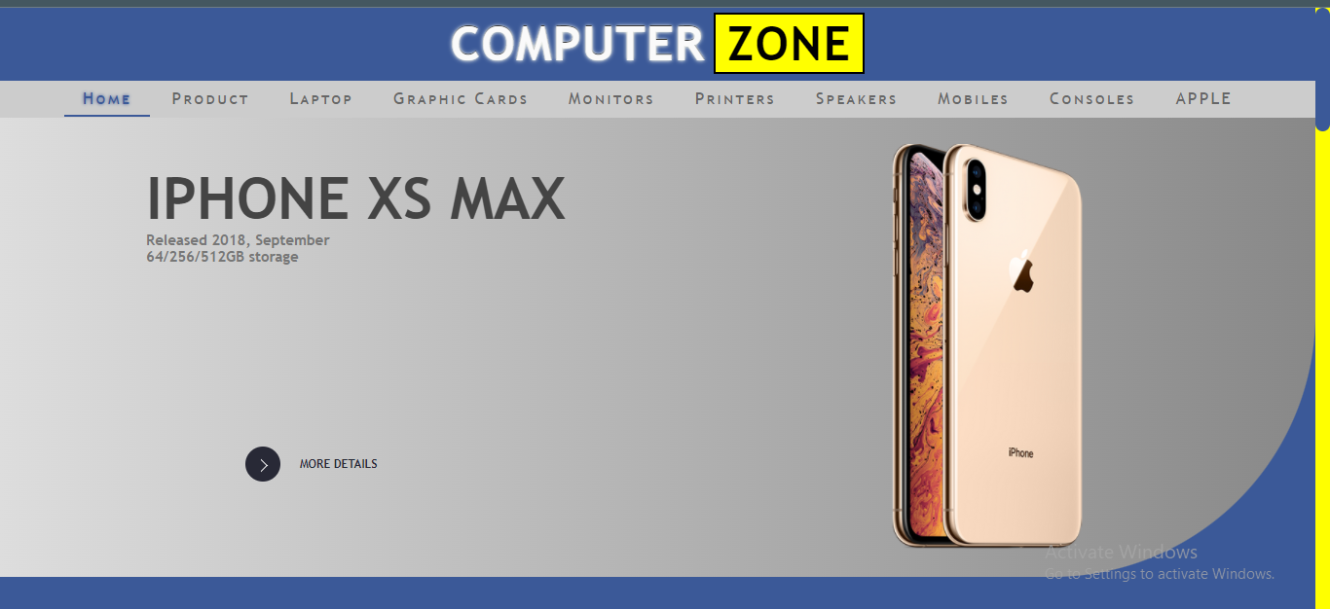
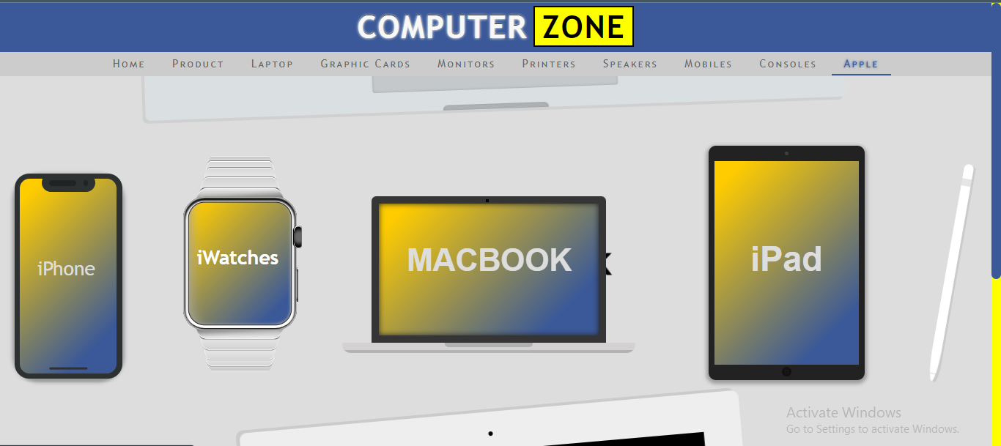

Slide 37
Tasks
3. Create cards layout. Use flex to make them responsive .For each card there must be a box shadow ,use border radius property for curved borders. By default images should be black and white and on hover they must turn in colored images. Rest of on hover animmations can be applied on text
Note: all animations should be smooth(use transition).choose good colors for gradients. Set font sizes using “em” property

Slide 38


